Slide 1
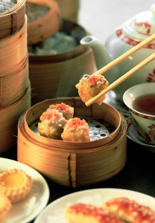
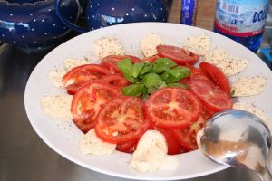
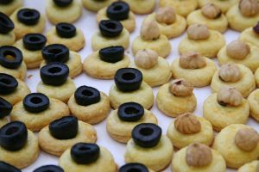
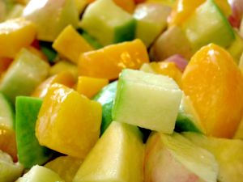
PREPARE APPETISERS AND SALADS
D1.HCC.CL2.12
Notes:
Trainer welcomes trainees to the class and informs them that they will be learning how to prepare appetisers and salads.

Slide 2
Prepare Appetisers and Salads
This Unit comprises three Elements:
Element 1: Prepare and present a selection of hot and cold salads
Element 2: Prepare and present a selection of hot and cold appetisers
Element 3: Store appetisers and salads including garnishes and accompaniments
Notes:
Trainer advises students this Unit comprises three Elements, as listed on the slide explaining:
Each Element comprises a number of Performance Criteria which will be identified throughout the class and explained in detail
Students can obtain more detail from their Trainee Manual
The course presents advice and information but where their workplace requirements differ to what is presented, the workplace practices and standards must be observed.

Slide 3

Assessments
Assessment for this Unit may include:
Oral questions
Written questions
Work projects
Workplace observation of practical skills
Practical exercises
Formal report from employer or supervisor
Notes:
Trainer advises students that assessment for this Unit may take several forms all of which are aimed at verifying they have achieved competency for the Unit as required.
Trainer indicates to students the methods of assessment that will be applied to them for this Unit.

Slide 4

Prepare and present a selection of hot and cold salads
1.1 Select ingredients to meet requirements of the hot and cold salad menu items
1.2 Prepare salads to enterprise standards including nutritional and eating qualities
1.3 Prepare garnishes and accompaniments
1.4 Present salads including garnishes and accompaniments according to enterprise standards
Notes:
Trainer identifies for students the Performance Criteria for this Element, as listed on the slide.

Slide 5

Prepare appetisers and salads
Terminology
Read through Glossary of Terms
What do you know?
Notes:
Trainer to take Students through Glossary of terms in Trainee Manual.
Activity:
What words do they already know?
Direct Student to website: www.marketfresh.com.au.
This is an excellent website that will take them through many of the Fruit and vegetables found in Australia.
Direct them to ‘marketfresh’ downloads
Download the top Four (4) Flyers: Fruit Guide; Vegetable Guide; Tropical and Exotic Fruit Guide; Asian Vegetable and Herb Guide0
Start to build Electronic Library - Save resources to Memory Stick or Flash Drive.

Slide 6
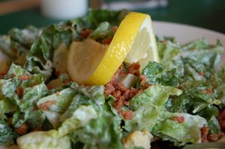
Hot and Cold Salads
Concept of Salads
Cold
Hot
Cultural
Theme
Modern Salads come from cuisines all over the world.
Notes:
Trainer to Introduce the Unit and discuss the ‘concept’ of ’What is a Salad?’.
Traditionally it is considered lettuce leaf base with dressing
Modern interpretations go much further
Cold
Modern twist, ’Hot Salads’’ Warm dressing splashed over leaf salad, actually just warm.
Give Examples: refer to Classics found in any book: Caesar, Waldorf, or to dressings,’ Blue Cheese’, ‘Thousand Island’
What is Classical? Asian; European; American; African; South American.

Slide 7
Select Ingredients
What makes a Good Salad?
Fresh Ingredients
Simplicity
Do not over complicate the eating or preparation
Colour
Bright Vivid, Stimulate the senses
Notes:
Trainer to talk about fresh Ingredients
Leafy type vegetables
Life of fresh leafy ingredients is short
Purchase everyday, if possible
Storage in controlled environment, Chilled, covered.

Slide 8
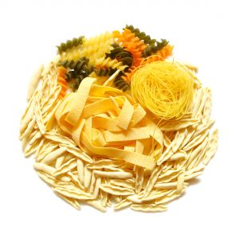
Select Ingredients
Cooked Ingredients
Root vegetables:
Potatoes
Meats:
Need to be cooked chilled
Pastas:
Need to be cooked, chilled
Lentils and other legumes
Notes:
Trainer to discuss the use of cooked ingredients in salad use
Most will be cooked then chilled
When using in salads time must be allowed for dressing flavour to permeate the cooked food.

Slide 9
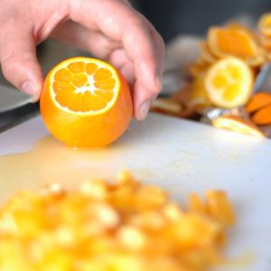
Select Ingredients
Fruits
Purchasing requirements
Storage Requirements
Preparation Requirements
Life of prepared products
Notes:
Trainer discusses best way to purchase, store, prepare fruits to be used in salads
How long will this prepared product keep?

Slide 10
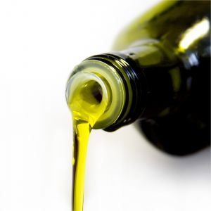
Select Ingredients
Dressing
Dressings an integral part of all salads:
Adds flavour
Moisture
Food value
Will give salads that WOW factor:
Fresh Ingredients
Crisp Flavours
Notes:
Trainer discusses:
Dressings and their impact on the eating quality of the salad
Importance of producing dressing in small batches to keep them fresh and alive.

Slide 11
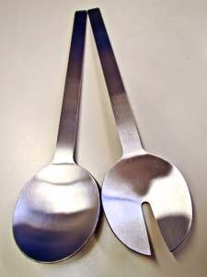
Prepare Salads
Mise en place
Everything is place:
Have all ingredients prepared before you start
Follow Standard recipes
Every salad looks the same as the last
Notes:
Trainer discusses:
Preparation of Salads; both cold and hot
Importance of correct preparation
Importance of presentation.

Slide 12
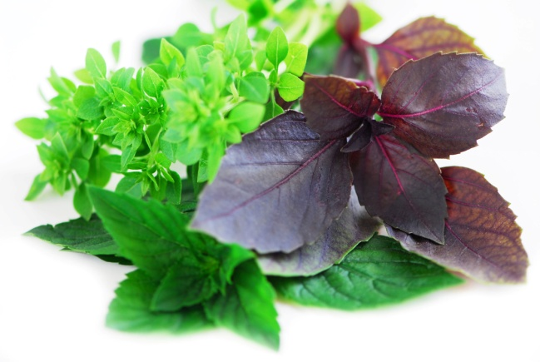
Prepare Garnishes
Type of garnish
Fresh
Cooked:
Cooked is produce first
Fresh Garnish should be left to as close to service as possible
Notes:
Trainer Discusses:
Garnishes integral to dish
Should compliment, not dominate.
Mise en place requirement
Most difficult production should be completed before the difficult production.

Slide 13
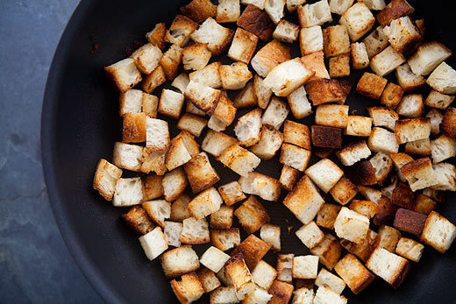
Prepare Accompaniment
Accompaniments
Side dish:
Dressing on the side
Fried herbs
Croutons
Notes:
Trainer discusses:
These can be prepared ahead of time but the same principle applies
Fresh is best.

Slide 14
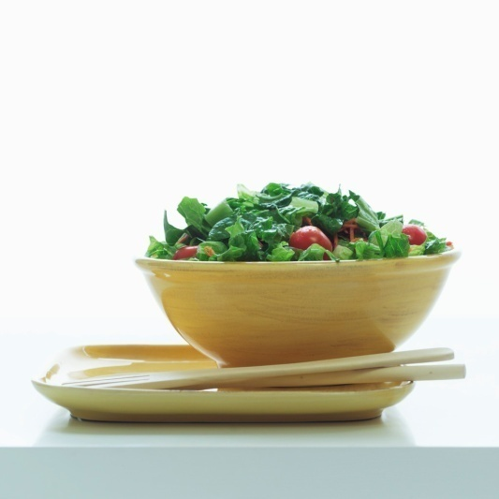
Salad Presentation
Presentation Style
Buffet Service:
On large Platters
Bowls
Single Service:
Individual bowls
Notes:
Trainer to discuss:
Advantages
Disadvantages
Preparation requirements for each.
Trainer to discuss:
Work project requirement.

Slide 15
Prepare and present a selection of hot and cold appetisers
2.1 Select ingredients to meet requirements of hot and cold appetisers menu items
2.2 Prepare appetisers to enterprise standards including nutritional and eating qualities
2.3 Prepare garnishes, and accompaniments
2.4 Present hot and cold appetisers including garnishes and accompaniments according to enterprise standards
Notes:
Trainer to discuss:
Element: Prepare and present a selection of hot and cold appetisers
Performance criteria: Explain them.

Slide 16
Prepare Appetisers
Interpretation
Modern
Classical
Amuse Gueule
Amuse Bouche
Notes:
Trainer to discuss:
Appetisers
Canapés
Finger Food
Service styles in Restaurant, Cocktail parties.
Students to discuss relevance to styles where they live and work.
Research on internet
Search terms out using Google - Amuse-bouche and Amuse-gueule
Add to culinary terms to Glossary.

Slide 17
Prepare Appetisers
Hot and Cold
Cocktail Food:
Stand up pre-dinner drinks
Served without customers seating:
Served from platters by wait staff
Notes:
Trainer to Discuss:
Types of service style.

Slide 18
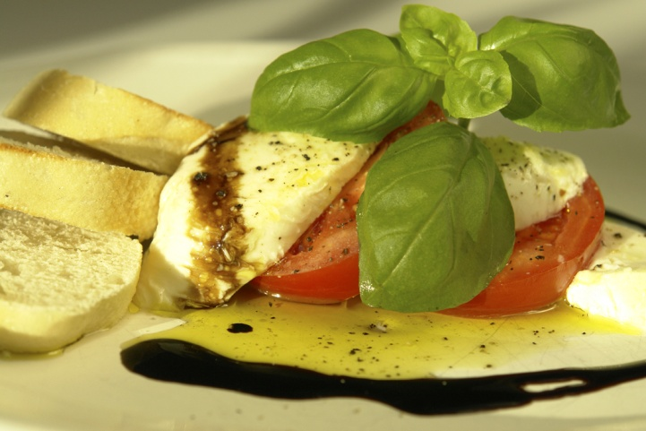
Prepare Appetisers
Eating Quality and Nutritional Value
Fresh is best
Not too much processed food
Different cooking style:
Grill
Poach
Steam
Notes:
Trainer to discuss:
Benefits of different styles of cooking
If all food is fried then the customers become bored
Different textures give different pleasure when eating.

Slide 19
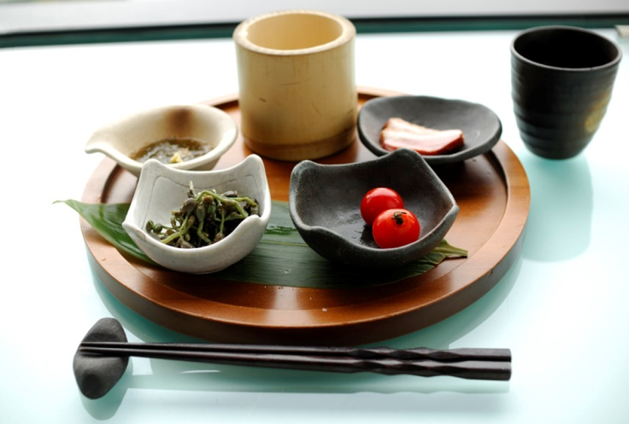
Prepare Appetisers
Garnishes
Complementary to the dish
Should not dominate
Refreshing to the mouth
Accompaniments
Texturally diverse to the main component of the dish
Crouton
Sauce
Notes:
Trainer to discuss:
What is the role of the Garnish?
Parsley- to refresh the mouth
Coriander- refreshing as well as flavour enhancing.
What is the role of the Accompaniment?
Adding textural diversity to a dish bring the eating sensation to a new level.

Slide 20
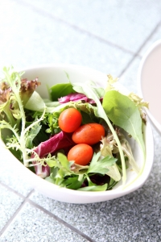
Prepare Appetisers
Presentation
Stimulate interest
Encourage customers to indulge
Anticipation level before consuming
Stimulate conversation
Notes:
Trainer to discuss:
Benefit of food looking inviting to eat
Encouraging the customers to enjoy the food
The conversation is about how good the food was and telling all their friends that they must all go to dine at this terrific place
Modern methods of ‘food blogging’ and people ‘tweeting’ friends when they are out dining are now becoming very common.
Discuss work project with Students

Slide 21
Store Appetisers and Salads
3.1 Store under appropriate conditions and locations to ensure freshness and quality
3.2 Store in appropriate containers
3.3 Labeling storage containers
3.4 Ensure economic viability of preparation and holding qualities
Notes:
Trainer to discuss:
Element: Store appetisers and salads including garnishes and accompaniments
Performance Criteria: Expectations.

Slide 22
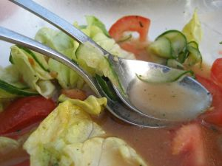
Store Appetisers and Salads
Before cooking
Keep chilled
Keep wrapped, protected from outside contamination
After cooking
Cool to room Temperature
Serve to customers hot
After Serving?
Never
Notes:
Trainer to discuss:
What stage of production is the appetiser?
Why does it need to be stored?
What is the best way for the appetiser to be stored to prevent contamination and degradation of quality?

Slide 23
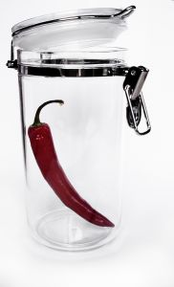
Store Appetisers and Salads
Quality Containers
Food grade
Impervious to liquids and colours
Washable
Able to be sealed
Hold food securely
Notes:
Trainer to discuss:
Containers must be fit to hold food as per the food safety plan
Must be in good condition with no scratches. If the scratches show as dark lines then there is bacteria in them and this could possible be dangerous to the consumer. Such container should not be used.

Slide 24
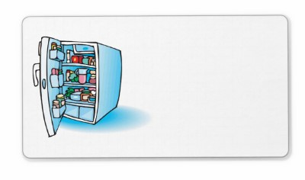
Store Appetisers and Salads
Labeling
Name of the product
Date of production
Name of person who produced
Store in correct storage environment
Use by date
Notes:
Trainer to discuss
Proper storage requirements:
It does not matter what is the production stage
Care must be taken to keep the product in optimum condition.

Slide 25

Store Appetisers and Salads
Economic Viability
The dish must be able to be sold and a profit to be made
Expensive ingredients kept to minimum
Portion size
Time taken to produce
Equipment need to produce
Skill of workforce
Notes:
Trainer to Discuss:
Main points on the PowerPoint slides
Work projects with Students.

Slide 26
Prepare Appetisers and Salads
End of this unit
Thank you
Notes:
Trainer concludes this unit and thanks trainees for their attention and participation.

